Slide 1

INFLUXDB SENG8080 - CASE STUDIES BIG DATA
SIHINT JIWANT SINGH (25%)
RAVAL PRATIKSHA MAHENDRABHAI (25%)
SINGH PADAMDEEP (25%)
IDODE IGBESKI (25%)

Slide 2
AGENDA
Introduction to Time Series Databases
Infux DB
Influx DB vs SQL server
Influx DB vs Cassandra
Influx DB vs Elasticsearch
Influx DB vs Open TSDB
Computer Processor Analysis Project

Slide 3
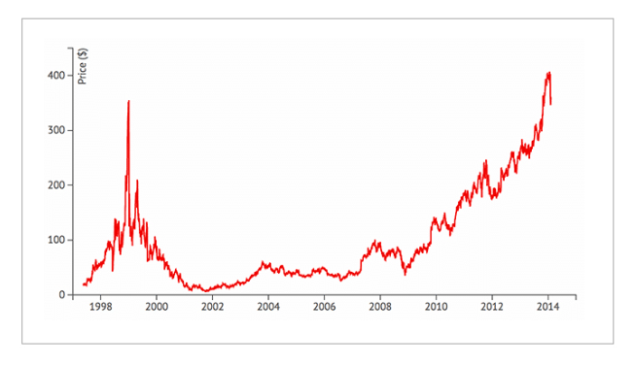
TIME SERIES DATABASE
A time series database (TSDB) is a database optimized for time-stamped or time series data.
Time series data are simply measurements or events that are tracked, monitored, collected and aggregated over time.
Examples : Weather Data, Stock Prices

Slide 4
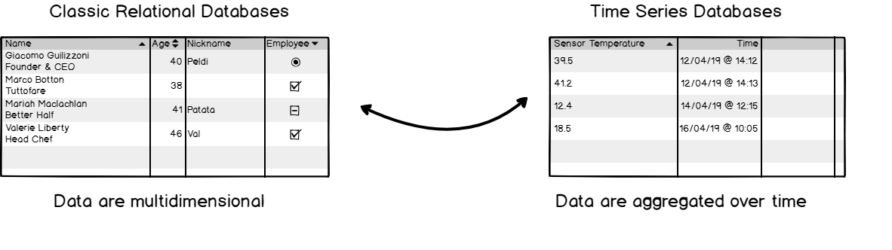
Difference between Relational Database and Time series Database
Time series databases work differently.
Data are still stored in ‘collections’ but those collections share a common denominator : they are aggregated over time.

Slide 5
PROPERTIES OF TSDBS
High write performance
Scalability
Fast Queries
Data Location
Usability

Slide 6
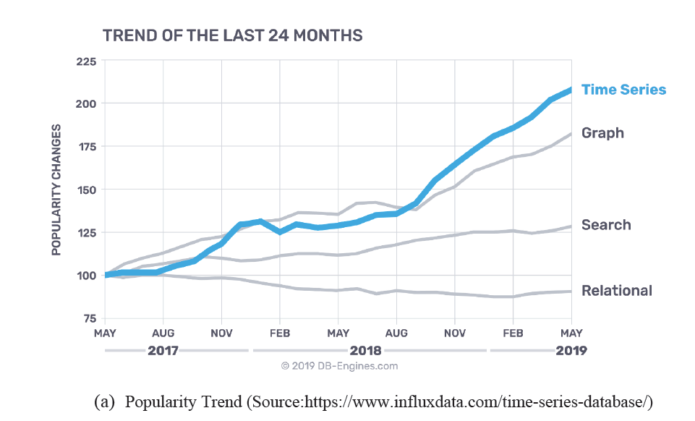
POPULARITY OF TSDBS

Slide 7
BENEFITS AND USES OF TSDBS
Low Cost
Reduced Downtime
Improved Business Decisions
Scalability and Performance improvement

Slide 8
INFLUXDB
InfluxDB is a time series database which was created and designed by InfluxData, the database was written in a programming language called GO programming Language. InfluxDB is designed for metrics and events using its time series platform to handle high workload in a fast, high availability and retrieval of time series data.

Slide 9



USE CASES
IOT (INTERNET OF THINGS)
REAL-TIME ANALYTICS
DEVOPS

Slide 10
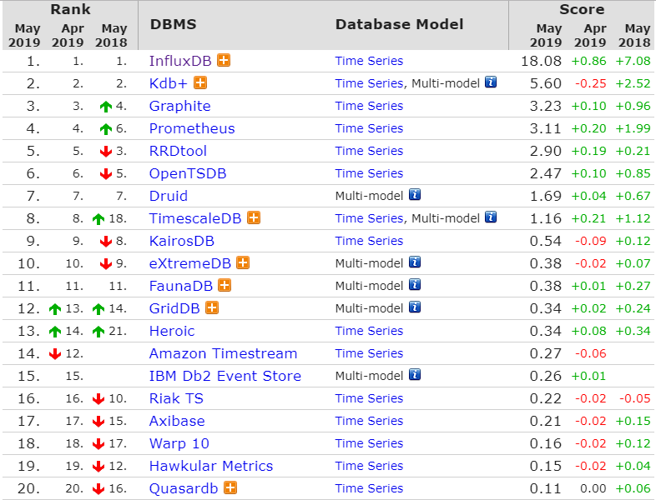
INFLUXDB RATING
https://db-engines.com/en/ranking/time+series+dbms

Slide 11



INFLUXDB VERSIONS
OPENSOURCE TICK STACK
INFLUXDB CLOUD
INFLUXDB ENTERPRISE

Slide 12
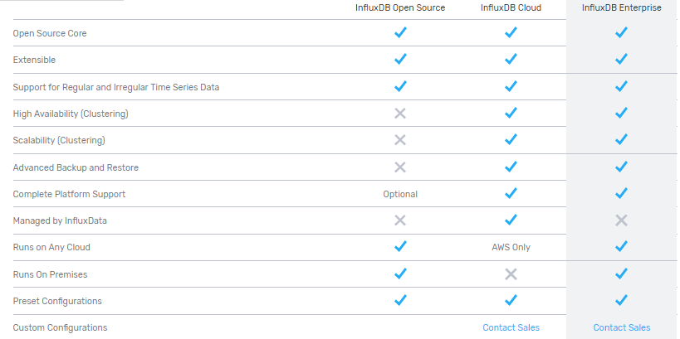
PACKAGES SUPPORTED BY VERSIONS
https://www.influxdata.com/products/editions/

Slide 13
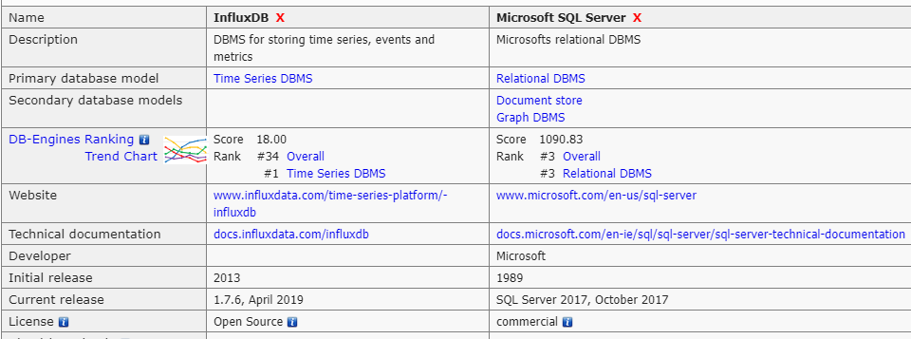
INFLUXDB VS SQL SERVER
System Properties Comparison InfluxDB vs. Microsoft SQL Server. (n.d.). Retrieved from
https://db-engines.com/en/system/InfluxDB;Microsoft SQL Server

Slide 14

CONTINUE…
1. provides prediction about schema preferences that they may vary during time which is beneficial while dealing with large datasets.
2. Datapoints in InfluxDB have one or all field measurements, which helps in adding new fields without extra burden.

Slide 15
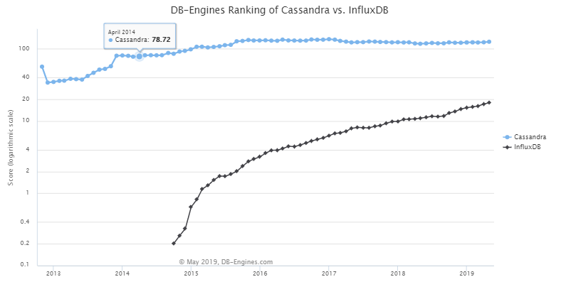
TREND CHART

Slide 16




CONTINUE…
Both Cassandra and Influx DB are open source but the implementation languages are different in both as Cassandra has Java and Influx DB has Go.
The Server operating systems are BSD, Linux, OS X, Windows for Cassandra, where as only Linux and OS X supports Influx DB.
The typing in Cassandra is enables and can be of ay type where as in Influx DB it is only Numeric Data and Strings.
Triggers, which plays main part in some of the databases are introduced in Cassandra but are not used or are programmed in Influx DB.

Slide 17
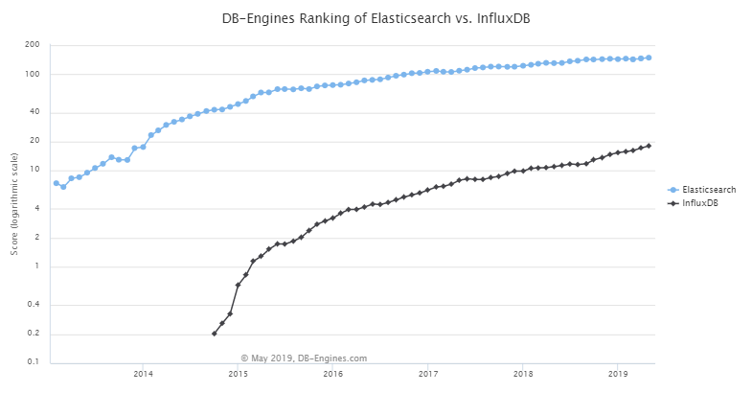
TREND CHART

Slide 18
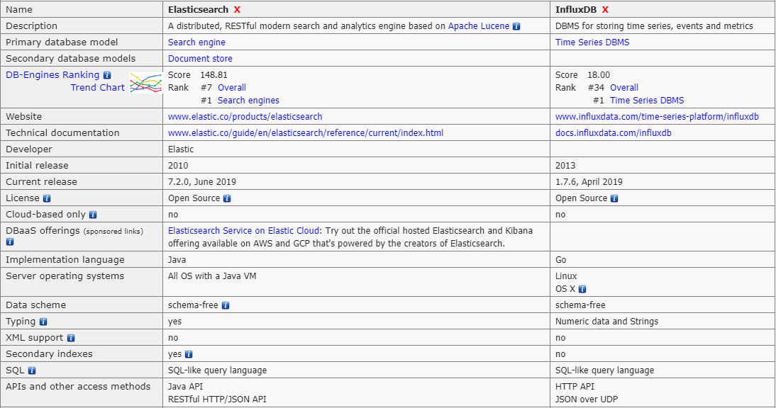
INFLUXDB VS ELASTICSEARCH
System Properties Comparison Elasticsearch vs. InfluxDB. (n.d.). Retrieved from https://db-engines.com/en/system/Elasticsearch;InfluxDB

Slide 19
CONTINUE…
In DB Engines ranking, the Elasticsearch stands at overall rank of 7 with score 148.62 whereas same as above, Influx DB ranks at 34th position with score of 18.08.
The initial release of Elasticsearch was 2010 and that of Influx DB is 2013 as same described above.
The Influx DB is having the same release with version 1.7.5 and the Elasticsearch is having the current release in April,2019 with version 7.0.0.

Slide 20
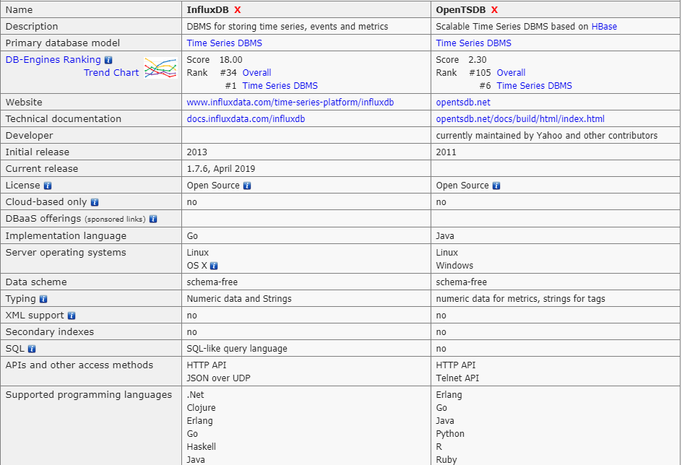
INFLUXDB VS OPENTSDB
System Properties Comparison InfluxDB vs. OpenTSDB. (n.d.). Retrieved from https://db-engines.com/en/system/InfluxDB;OpenTSDB

Slide 21
CONTINUE…
In DB-Engines ranking, the Influx DB stands high at number 34 with 18.08 score as OpenTSDB stands at far away in the rating at number 104 with score of just 2.47. Also, in time series DBMS influx DB stands at number 1st position whereas OpenTSDB stands at 6th position.
The server operating systems in Influx DB is Linux, OS X whereas in OpenTSDB, is Linux and Windows.
Data schemes in both the DB-Engines are schema free.
In influx DB, the typing is Numeric data and Strings, which is almost same for OpenTSDB, the only addition is of tags in it.

Slide 22
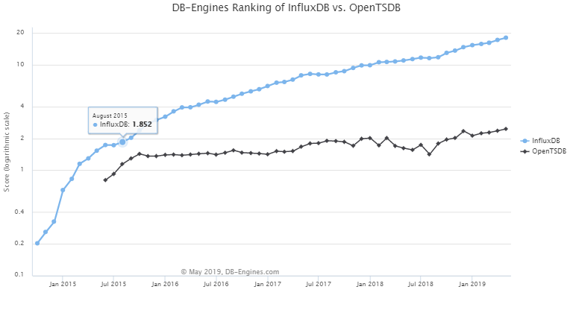
TREND CHART

Slide 23
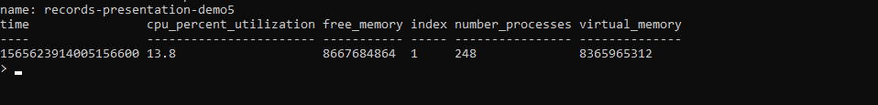
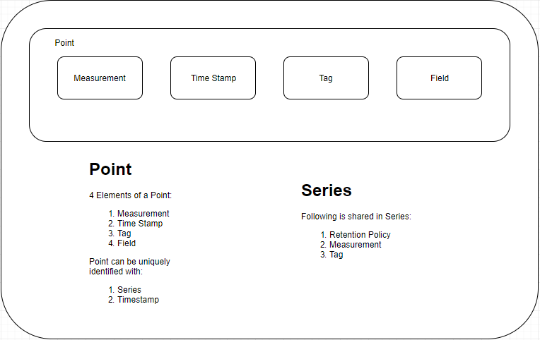
InfluxDB Concepts

Slide 24
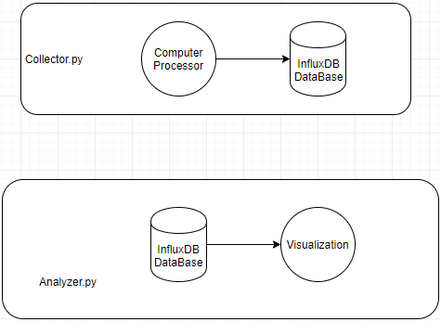
InfluxDB Application

Slide 25
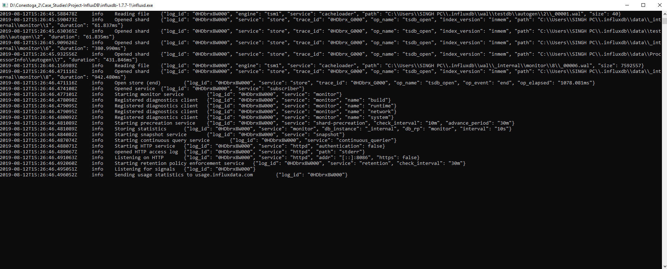
InfluxDB Server …..Towards Application

Slide 26
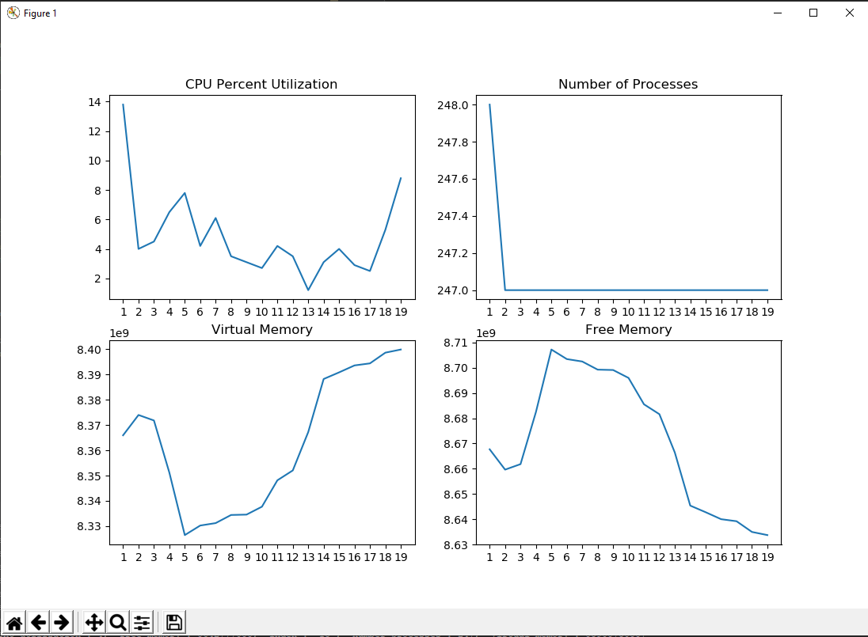
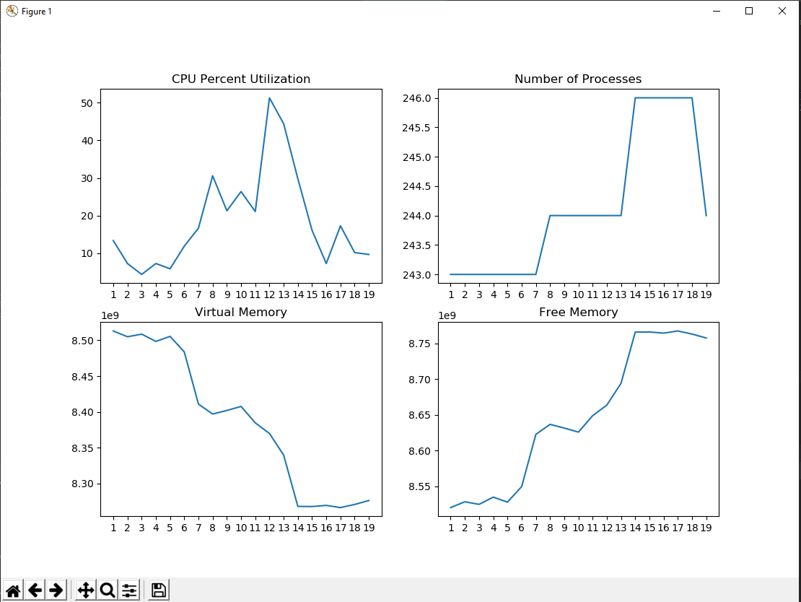
Project - Statistics Analysis
Visualization - Without Stimulus
Visualization - With Stimulus

Slide 27
REFRENCES
[1] "InfluxDB 1.7 release notes". Retrieved 2 April 2019.
[2] InfluxData, “Time series database (TSDB) explained” [Online]. Available:
https://www.influxdata.com/time-series-database/
[3] InfluxDB Website to analyze different editions:
https://www.influxdata.com/products/editions/
[4] InfluxDB IOT Data Platform: https://www.influxdata.com/customers/iot-data-platform/
[5] InfluxDB Real Time Analytics: https://www.influxdata.com/customers/real-time-analytics/
[6] https://en.wikipedia.org/wiki/InfluxDB
[7] https://www.influxdata.com/products/compare/
[8] Using psutil to get Data from computer processor: https://pypi.org/project/psutil/
[9] Using influxdb to interact with Influx DB Database:
https://github.com/influxdata/influx-python
[10] Using influxdb connections with Influx DB Database:
https://www.influxdata.com/blog/getting-started-python-influxdb/
[11] Using Pandas for dataframes: https://www.geeksforgeeks.org/python-pandas-dataframe/
[12] Using matplotlib for plotting real time data: https://matplotlib.org
[13] Using seaborne for visualizing Data:
[14] https://jakevdp.github.io/PythonDataScienceHandbook/04.14-visualization-with-seaborn.html
[15] Repository Reference: https://github.com/Jiwant/Project-InfluxDB

